Slide 1



FINAL YEAR PROJECT
PRESENTED BY:
ABHISHEK VERMA 2100290120008
ABHISHEK RAJPUT 2100290120007
ANURAG KUMAR 2100290120039
ARYAN TOMAR 2100290120052

Slide 2


PROBLEM STATEMENT:
ONLINE EXAMINATION AND EVALUATION SYSTEM
PROJECT ID - PCS25-42

Slide 3



OUR TEAM MEMBERS
PROF. SHIVANI
ABHISHEK VERMA
PROJECT GUIDE
TEAM LEADER
ARYAN TOMAR
ABHISHEK RAJPUT
ANURAG KUMAR
TEAM MEMBER
TEAM MEMBER
TEAM MEMBER

Slide 4




OBJECTIVES :
04
Enable convienient and flexible Testing
Ensure test security and integrity
Streamline test creation and management
Automate Evaluation and Grading while improving Efficiency and Accuracy
Facilitate Collaboration and Communication
Ensure data privacy and security

Slide 5

MILESTONES
Stage
1
Stage
2
Stage
3
Stage
4
Stage
5
Stage
6
Study of reaserch paper
Exploring Technology to be used
Learning required technology
System Design and Coding
Implementation
Testing & adding extra feature
Reviewing and Publishing Reasearch Paper

Slide 6





CURRENT PROGRESS
6/6
ALL STAGE PASSED
s

Slide 7


TIME DURATION
Stage 1
Stage 4
TIME REQUIRED : 6 WEEKS
02
TIME RQUIRED : 3 WEEKS
03
Stage 2
Stage 5
01
TIME RQUIRED : 12 WEEKS
06
TIME RQUIRED : 3 WEEKS
04
Stage 3
Stage 6
05
TIME RQUIRED : 12 WEEKS
TIME RQUIRED :4 WEEKS

Slide 8


LITERATURE REVIEW
Inferences From Literature Review :
A. Malpractices and Suspicious Activities :
Due to the absence of supervision during the exams, identification of the rule violators is difficult. Students refer to their books, course materials and search engines while giving exams
B. Identification and Verification :
While giving the exam the identification and verification of the correct student is not done right at that moment that is, either not done, or done after the exam and as a result any unauthorized person can give exam in place of the authorized candidate.

Slide 9
C. Infrastructural Barriers :
Continuous internet connection is required while giving the exam. If connectivity is lost then either student has to give the whole exam again or resumes from same point after logging in again. This causes distraction and disturbance as a result student loses focus. Also many exam systems only allow giving of exam on computers with webcam so the students without computer or laptop either have to go to the cyber café or other places with public computers or they cannot give exams
D. Use of Human Evaluators and Proctors :
Many online exam systems are using human proctors for monitoring the activities of the students while giving exams through snapshots taken by their (students’) webcam. Moreover, some hire humans to evaluate the theoretical responses of the students. This not only increases the cost of conducting exams but also somewhere affects the speed and accuracy of evaluation.

Slide 10
SDG MAPPING
1.SDG 4: Quality Education :
Ensures inclusive and equitable quality education for all.
Enables remote assessments, reducing geographical and economic barriers.
Provides personalized learning experiences with immediate feedback.
2. SDG 9: Industry, Innovation, and Infrastructure :
Utilizes AI, machine learning, and big data for efficient evaluation.
Supports automated grading, plagiarism detection, and real-time monitoring.
Cloud-based systems ensure secure storage and easy retrieval of assessment records.

Slide 11
SDG MAPPING
3.SDG 10: Reduced Inequalities :
Creates a fair and inclusive assessment process.
Allows students from remote and underprivileged areas to take exams online.
Incorporates accessibility features like screen readers and multilingual support.
4. SDG 13: Climate Action :
Reduces paper usage, printing, and transportation, lowering carbon emissions.
Promotes a more sustainable and eco-friendly examination process.
5. SDG 16: Peace, Justice, and Strong Institutions :
Ensures transparency, fairness, and accountability in assessments.
Uses biometric authentication, AI proctoring, and blockchain for security.
Builds trust in educational credentials and institutions.

Slide 12
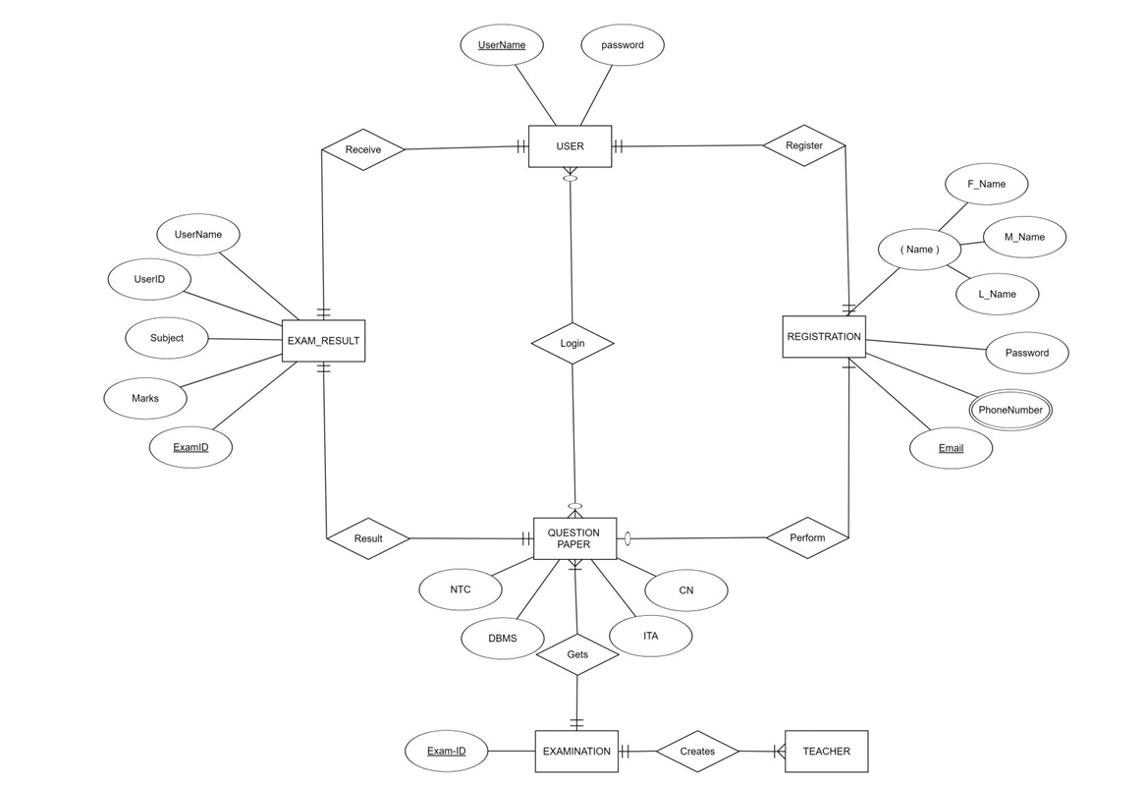
ER DIAGRAM

Slide 13
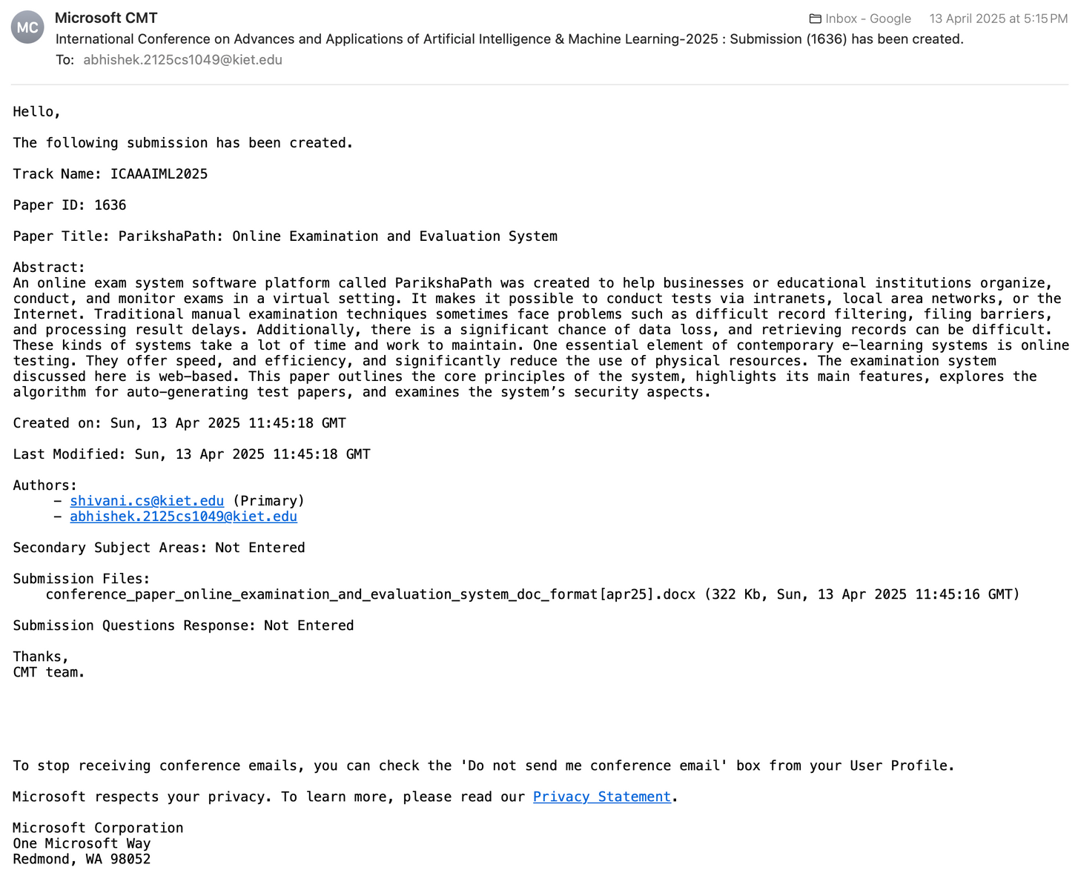
RESEARCH PAPER SUBMISSION PROOF

Slide 14
PRESENTED BY GROUP-PCS-25-42
Thank you!

